Slide 1
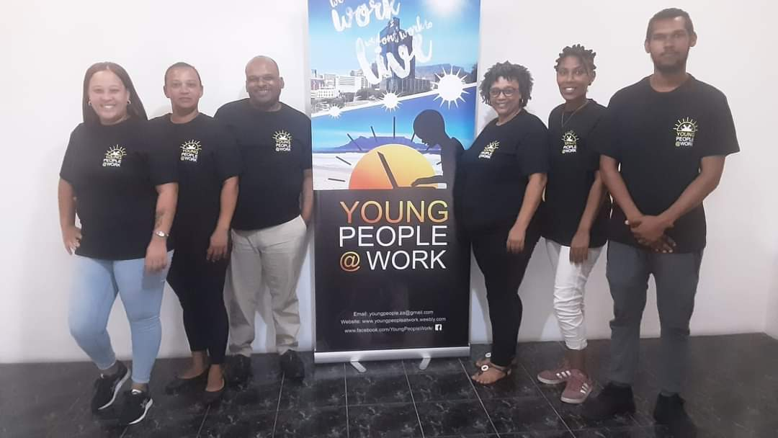
YOUNGPEOPLE@WORK We Live to Work, We don’t Work to Live!
NPC 2012/210099/08 - PBO registration: 930062239 IT: 931/031/18/5
Providing an innovative solution to youth unemployment!!
Updated: 14 April 2022

Slide 2
Contents
The incubator strategy
Where we come from – following in the traditions of RAG
How we differ from our predecessor?
Normalising the abnormal! The scourge of youth unemployment!
How we see our youth and our values
How do we operate? Our integrated strategies for intervention
Our programmes
Community Information Sessions/Youth Leadership Forum
Youth Empowerment Week
Computer and Life Skills Academy (also via WhatsApp)
Online Job Search Training (also via WhatsApp)
Community Investment Programme
Rural Outreach
Practical Office Administration
Radical Car Wash
Youth Business Network
Master Train the Trainer Course
Our strategic partners and our approach to partnership development
How we market our programmes and approach to marketing
Job placement and tracking/referrals -What we monitor and evaluate?
Stories and faces of successful interventions
Feedback from our Facebook page and our partners
Who is involved in YP@W
Auditors and banking info
How to contact us

Slide 3
Frank Julie and Associates The Incubator Strategy
1978 – 1991 (Involvement in NGO, political, student, youth, civic, cultural and sport organisations)
1992 – 2003 (Launched Resource Action Group/Youth Development Network)
Frank Julie and Associates (2003-2022)
YoungPeople@Work
People First Foundation
Fund Mentoring Network
Music Academy for Rural Youth
Food Relief Alliance of SA
Radical Car Wash

Slide 4
Where we come from
YoungPeople@Work is the brainchild of Frank Julie and
Marileze Johannes. Both were part of the first generation members of the Resource Action Group (RAG), a non-profit youth development agency established in 1992.
Frank Julie was the founder and executive director of RAG for 11 years before departing in 2003 to pursue a career as fulltime development consultant. He authored three books namely on leadership and management, a study on the Roots of the NGO crisis in SA – a look beyond the surface and Fundraising Strategies for Struggling NPOs. He obtained a MPhil in Adult Education and Development from University of Cape Town where he also acts as guest lecturer.
In 2007 RAG collapsed due to a lack of funding and mismanagement. In 2009/2010 the first generation of RAG volunteers and staff regrouped and decided to re-launch the rebranded organisation under a new name – YoungPeople@Work. YP@W was launched on 27 March 2012 and formally on 27 November 2012. Many of the professional volunteers supporting YP@W today have their roots in RAG where they were trained and graduated and now give back to the community.

Slide 5
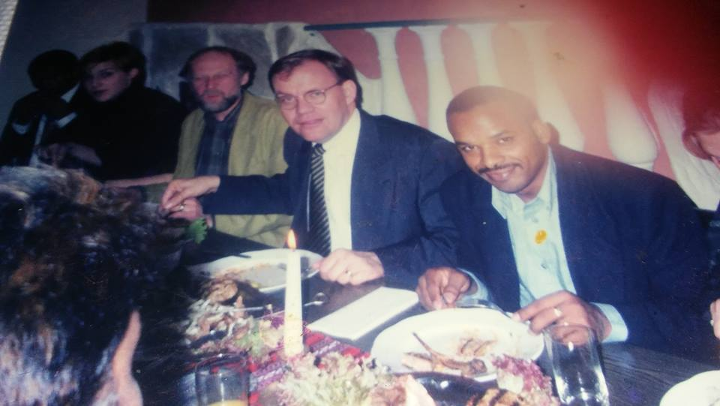
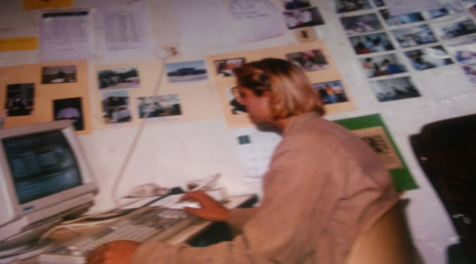
More about RAG …
RAG was built from scratch. It started as a resource centre by the Western Cape Society for Alternative Structures (WECSAS) and then transformed into a fully fledged non-profit organisation in 1993. It was built from the bedroom of its founder, Frank Julie.
The organisation grew with leaps and bounds. Its offices and training centre were initially based in Bishop Lavis/Nooitgedacht and later moved to Athlone. Its high standards of training and its model of youth development attracted the attention of many donors. Interns from various countries such as The Netherlands, Belgium, Switzerland and Germany were referred to RAG. It was also instrumental in establishing the Youth Development Network based in Johannesburg.
Frank Julie meeting with
the SA ambassador
in The Netherlands in 1998
Anouk Muller, an intern from
Holland (1999)

Slide 6
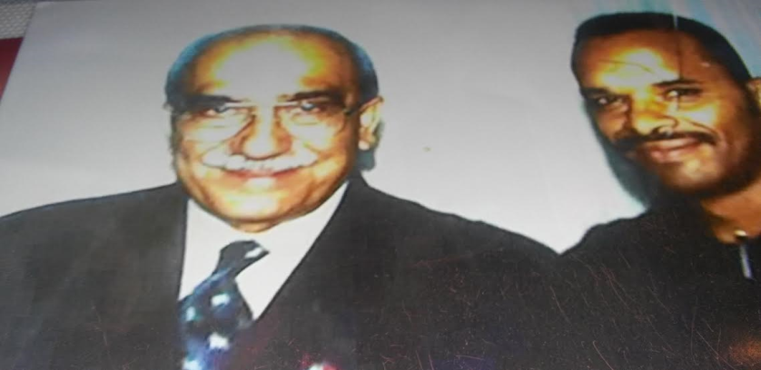
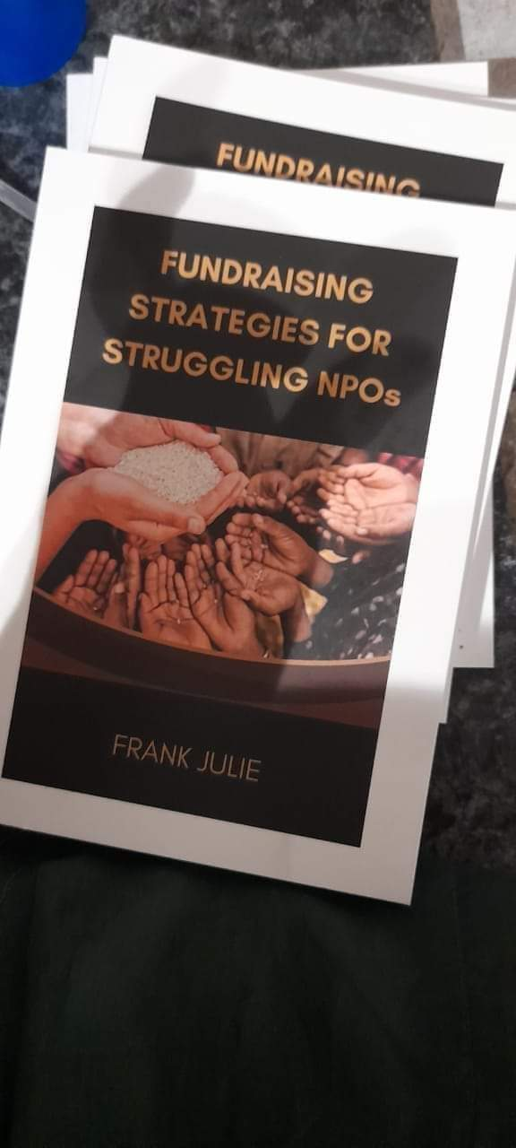
Continue
Frank Julie visiting the White House in the USA
Meeting Kader Asmal, Minister of Education
Books by Frank Julie
2010
2021
2006

Slide 7
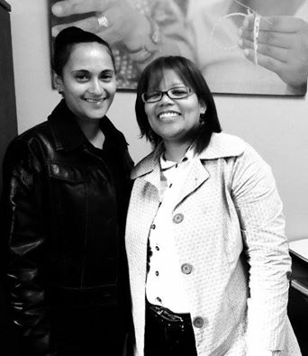
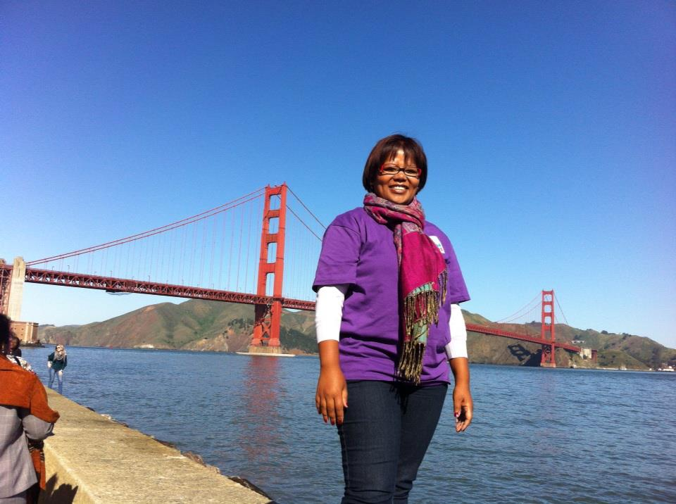
Continue…
Members of RAG travelled to various countries such England, Kenya, USA, Brazil, Germany, Egypt, Australia, The Netherlands, Switzerland and Mexico as delegates to conferences and field visits. Through its various programmes it trained youth leaders from around the country and Namibia. It is based on the accumulated experiences of RAG that YP@W draw from and is building on.
Soraya Mentoor (she was instrumental in
the launch of the International Youth
Parliament in Australia and African Youth
Parliament in Kenya)
Soraya in Mexico and with Erica Laban an
ex-volunteer at YP@W (and now marketing
manager at the Wheat Trust) at the
Wheat Trust where she was director. She
currently works for the Aids Rights
Alliance of Southern Africa (ARASA) as a
Facilitator.

Slide 8
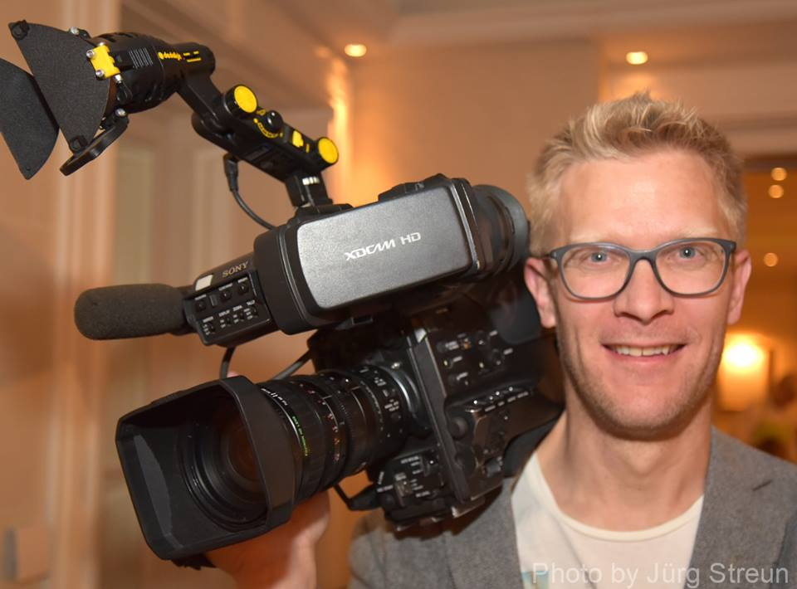
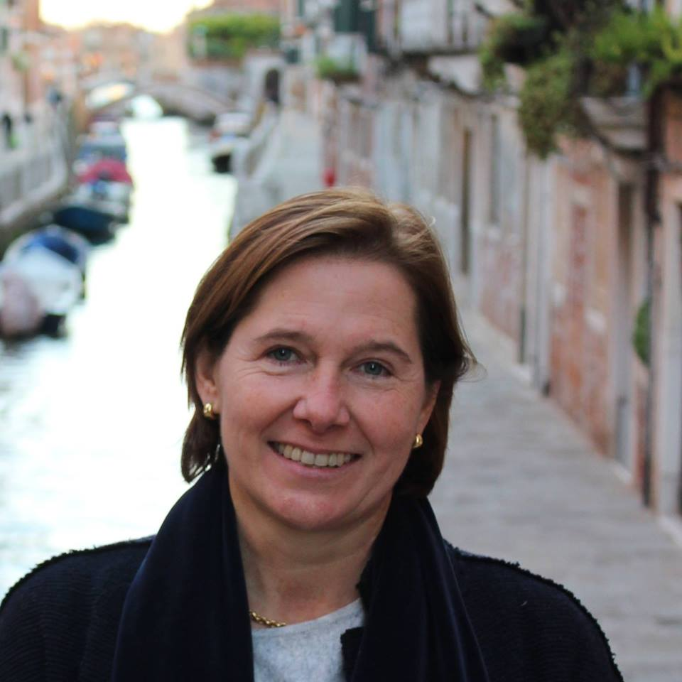
RAG in England, Switzerland, Belgium
Frank and Soraya in England
Goedele Zwanepoel from Belgium
Supervised by Frank Julie
Michi Lersch from Switzerland
Supervised by Frank Julie

Slide 9
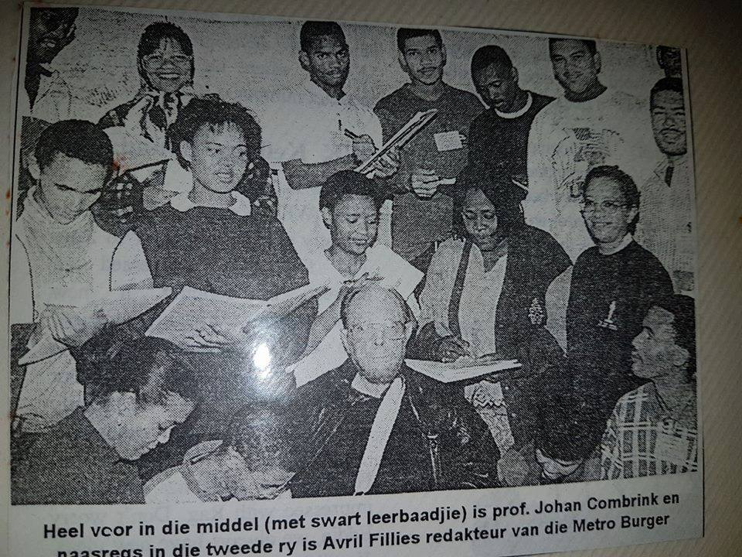
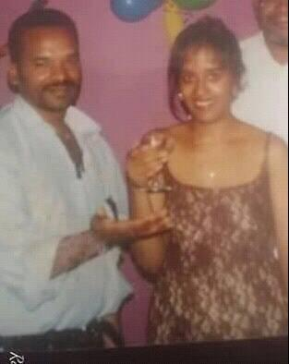
RAG in the 1990s
RAG members with Prof Johan Combrink, Petronella Petersen with RAG students, Frank Julie and Freda Camphor at RAG Kimberley graduation and Frank Julie with youth reps in the USA.

Slide 10
How we differ from RAG
RAG was almost entirely a centre based organisation. YP@W emphasise outreach as a core element of its strategy. About 60% of our work happens where unemployed youth live and have access to our programmes.
RAG developed a bloated staff consuming huge financial resources. YP@W works with a core staff and paid volunteers. We deliberately try to restrict staff costs to invest more in our programmes. At the same time we are aware that staff retention is vital and monetary reward is important for scarce skills to ensure quality of delivery and continuity.
RAG allowed access to its life skills programmes only to those enrolling for its computer course. YP@W allows access to everyone. This means that our quantitative impact is much bigger. Our focus on job placement and tracking is also more focused and structured. This element was outsourced by RAG at great financial costs.
Use of social media: In YP@W we use social media to great effect to market and educate our target group. We have a strong Facebook presence with regular updates and a current following of more than 65 000. We use whatsapp groups to communicate
our messages at very low costs.

Slide 11
Normalising the abnormal! The scourge of youth unemployment
According to official statistics, South Africa has the highest long-term youth unemployment rate among medium-income nations, with those between the ages of 15 and 24 accounting for 48.2% of those unemployed.
According to Stats SA: “Employment declined by 2,2% or 355 000 in Q1: 2016, which combined with an increase in the number of unemployed persons of 521 000 resulted in an unemployment rate of 26,7%; this was 2,2 percentage points higher compared to that reported in Q4: 2015.” The expanded unemployment rate which includes those who were available to work but did not look for work in the reference period also increased by 2,5 percentage points between Q4: 2015 and Q1: 2016 to 36,3%. In 2022 unemployment for youth was measured at 74%. This was also due to the Covid-19 crisis.
The social consequences are huge! For example, in South Africa there are 23 suicides a day recorded and 230 serious attempts.
One in four South African teens are ‘hooked on drugs or alco-
hol’.

Slide 12
Continue…
The huge challenge of youth unemployment is not always fully appreciated because the abnormal has been normalised! According to statistics about 74% f those categorised as youth in are unemployed in SA. In some rural areas it can be as high as 80%. This is 3 times higher than the unemployment rate during the Great Depression when it peaked at 24.9%. This effectively means that our youth are experiencing the effects of 3 Great Depressions on a daily basis.
SA has the highest rate of youth unemployment in Africa. There are various factors that contribute to this nightmare. The educational system does not produce the skills commensurate with the needs of a modern economy due to its apartheid legacy. The new government since 1994 has not been able to change much and in some areas have regressed. The economic system based on profit maximisation has led to jobless growth. The current economic stagnation has led to the shedding of jobs.
The biggest challenge however is the structural inequalities that led to a closed economy based on landlessness. SA was the only country where land dispossession was almost complete with 13% allocated to blacks and 87% to whites. This regime still largely persist today. No youth intervention programme can ignore these realities. Doing so will mean
reproducing this social order and creating false hope.

Slide 13
How we see our youth
YP@W is a new generation organization for unemployed young people by previously unemployed young people. Our vision is about young people engaged in productive work to enhance economic, social, cultural and spiritual development. We regard working on oneself as the most productive work! Instead of lying at home we encourage youth to constantly work on themselves, hence our belief in life long learning! In a rapidly changing economy with constantly new demands for being adaptive, working on yourself is vital.
In YP@W youth are not just recipients of predesigned programmes, but active participants in the design themselves. We regard youth as assets not liabilities. We believe they have inherent talents, strengths and positive energy that must be harnessed to facilitate their holistic development to their fullest potential. For example our management meeting is based on a rotational chair because we train leaders not followers! We train leaders by allowing our members to ACT as leaders! Our approach is hands-on and not chalk-and-talk!
We believe youth can be leaders today and not just tomorrow! In YP@W we redefine the concept of work as not just an economic activity to live and survive, but also as a social function that allows people opportunities to grow! Hence our motto:
We Live to Work – We don’t Work to Live!

Slide 14
Our values
Our members are driven by their passion to make a
difference in their community. Irrespective of our circumstances or lack of resources, we believe in a high quality and professional intervention. We are intolerant towards mediocrity!
In the execution of our work we uphold the values of:
Mutual respect for each other and our beneficiaries
Transparency in everything we do!
Accountability for our actions
Going the extra mile and maintaining high standards
Equality between members (nobody enjoys special rights and privileges)

Slide 15
How we operate – our model
Community and donors
Where our trainees come from
Strategic advisors
Shares intellectual capital and referrals, do free workshops
Volunteers
Support core staff, continuous training provided , access jobs
Core staff
Runs the key operations

Slide 16
About our model
Core staff: Since we launched in March 2012 we experienced a regular volunteer overturn. We had no staff members. We started paying small stipends in 2013 and recruited a small core staff. Only one person remained today of that team. Our lack of financial resources made it difficult to retain staff who could otherwise earn market related salaries. Currently we have 5 fulltime staff.
Volunteers: We recruit volunteers as the need arise and preferably from our student base. They are paid stipends for transport and sustenance. When employment opportunities arise we prioritise their applications. They are also considered for fulltime employment with YP@W as the need arise.
Strategic advisors: To minimise the cost of our programmes, we recruit various strategic advisors who offer free workshops, financial support, referrals, materials, etc. Some of them have been ex-members of RAG.
Community and donors: These are the people who attend our programmes and those who provide financial and material
support.

Slide 17
Our integrated strategies for intervention
Change mind-sets
Connect youth to opportunities
Share strategic information
Networking
Life-long learning

Slide 18
What our strategies mean…
Research indicate that at any one time about 859 000 opportunities exist in terms of job opportunities, learnerships, internships, etc. (Adcorp/Loan Sharp, ETV interview, 15 June, 2016) The challenge for many youth is access to these opportunities and support to use it to advance their careers and build sustainable livelihoods. However, due to the collapsing educational system, our youth are not always job prepared. Our strategies aim to address this.
Through training we change mind-sets – equip youth with relevant skills (life skills, computer skills, gain experience through job shadowing, mentoring, on the job training, etc.)
Connect youth with opportunities (referrals to training/education opportunities, employment (temporary or permanent).
Sharing relevant information through an effective and comprehensive communication strategy (Facebook alerts, CV Bank, SMS alerts, email alerts, word of mouth, exhibitions, door to door campaigns, etc.) Our aim is to break down the potential barriers between potential employer and employee.
Network with relevant stakeholders to add more value to our interventions in order to change mind-sets and see the big picture! And develop new vision!
Since the nature of work has become very unpredictable we promote a culture of life-long learning to stay relevant/productive and adaptive in a
rapidly changing technological and information era.

Slide 19
Points of contact and intervention
Job Placement/
Shadowing/
Tracking
CIS
Walk-ins
Computer academy
Online job search/free computer training
Life skills/via WhatsApp
Youth Empo-werment Weeks

Slide 20
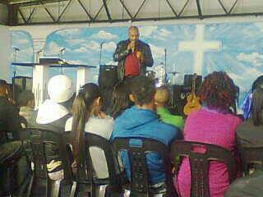
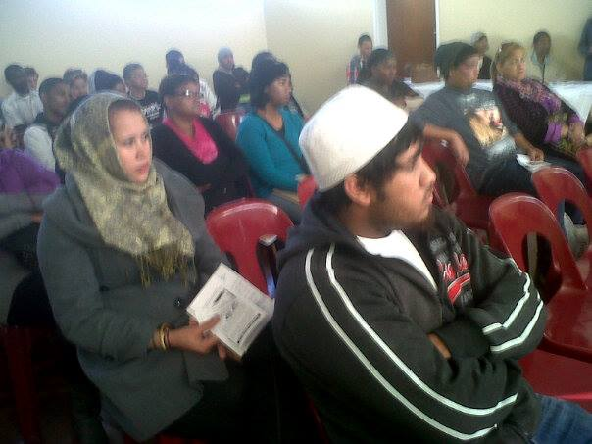
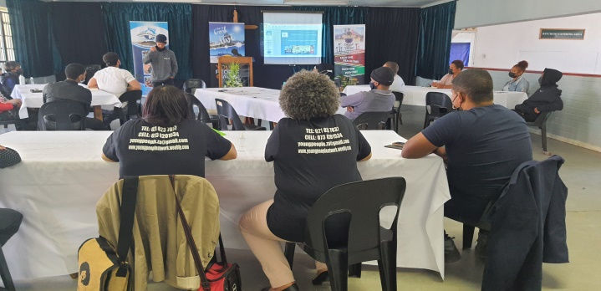
Community Information Sessions/Youth Leadership Forum
This is a rapid response to address the need for more information about our services. Youth are informed about our various projects and how they can benefit immediately. The host organisation takes responsibility to organise a venue, date and participants. This training has been interrupted during the Covid-19 crisis and is now alternatively presented as a Youth Leadership Forum. The focus with the latter is to identify youth leaders making a difference in various communities and to provide support base to deepen their skills level in order to maximise their impact.
CIS in Kensington, Delft and Bishop Lavis

Slide 21
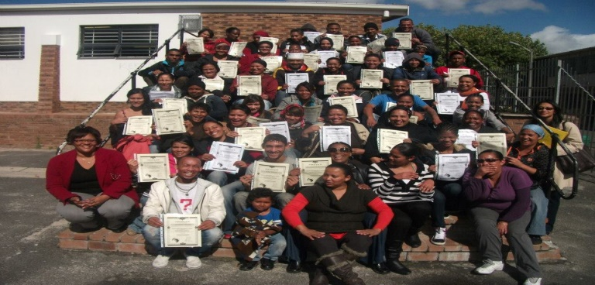
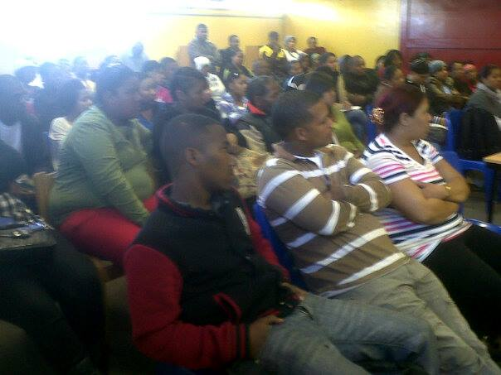
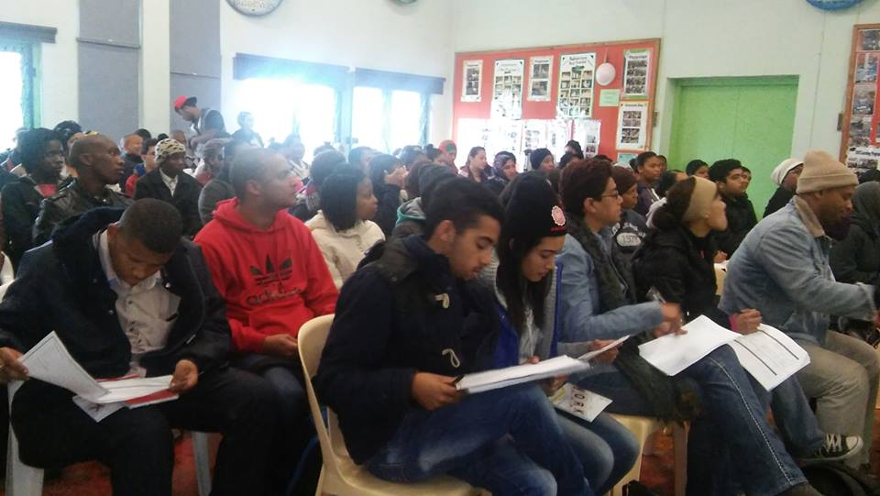
Youth Empowerment Week
Objective: To reach out to at least 70/80 unemployed youth in 5 communities per annum to share info, change mind-sets, complete and bank CV’s, sign up volunteers, and initiate free online job search training at the library. We partner with local stakeholders and over a period of 6 weeks and prepare the logistics, actual training and follow up. The workshops cover professional job seeking skills, CV writing, interviewing skills, how to access public employment, personal development and leadership and an exhibition with our strategic partners where more jobs and training opportunities are shared. We plan 10 YEW for per annum targeting at least 400 unemployed youth. Since the Covid-19 crisis this training has now moved online via WhatsApp. In 2021 we reached over 14 000 participants for the various sessions.
Bonteheuwel – Athlone – Elsies River

Slide 22
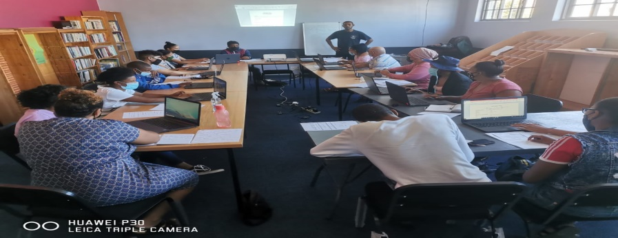
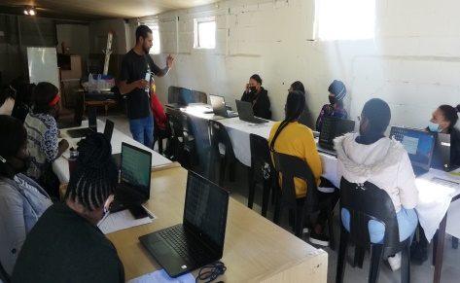
Online job search training
We partner with local community libraries and deploy
trained computer facilitators to train unemployed youth on
the Smart Cape computer network where we offer a 3 day intensive course over 2 hours per session focusing on: Introduction to computers, how to open a Facebook and email account, design a CV and upload into our CV Bank. They are introduced to websites advertising the latest job vacancies. A certificate of attendance is issued. The libraries are also used as the first entry point for job placements or referrals to opportunities. We have already reached about 1000 participants over the last 3 years. This programme addresses the issue of accessibility as well as safety and this security since it is located in walking distance from our beneficiaries. This training combined with MS Windows has also moved online via WhatsApp.
Training in Delft and Kuilsriver

Slide 23
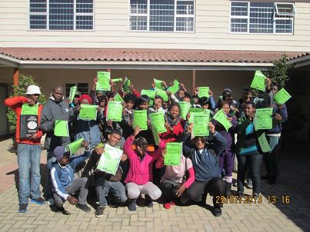
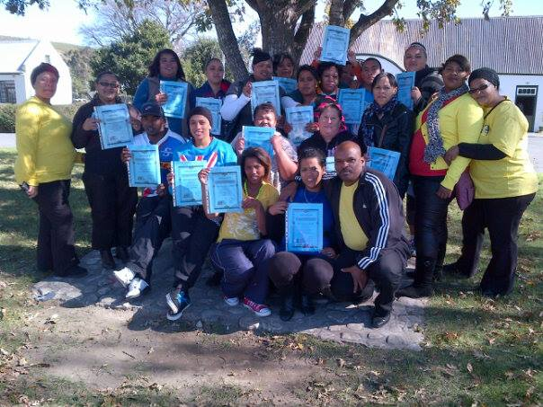
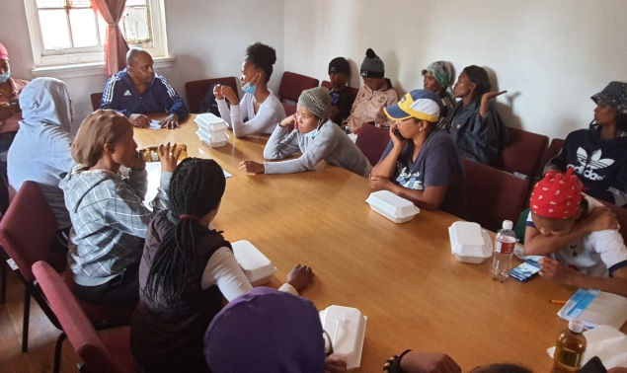
Rural Outreach Programme
Aim: Targeting unemployed youth in rural areas by replicating our youth empowerment week model.
Objective: reach at least 3 rural areas per annum focusing on info sharing, facilitating 3 life skills workshops and provide basic computer literacy using community resources. So far we trained youth in Doring Bay, Heidelberg, Zwelihle, Arniston and Suurbraak. For 2016 we are targeting youth in the Boland region. We work through local partners since the follow up component is very important.
Nelspoort, Zwelihle and Suurbraak Rural Outreach

Slide 24
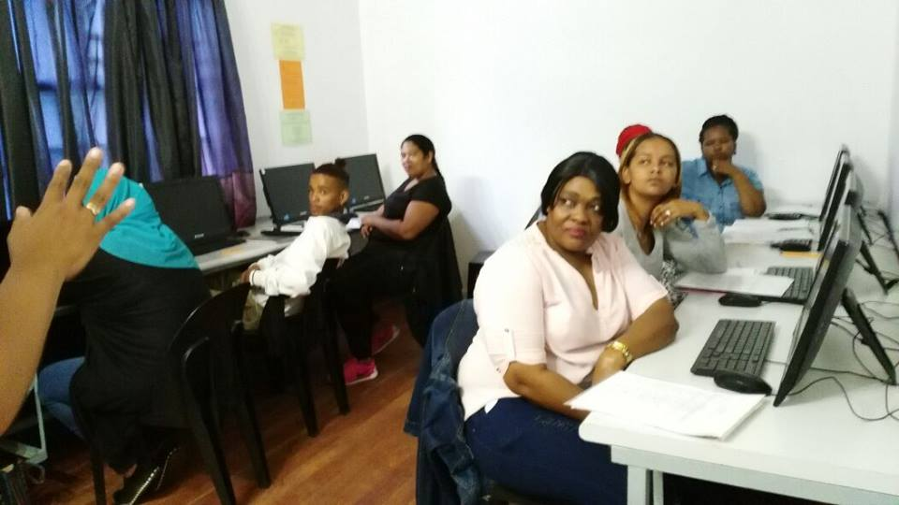
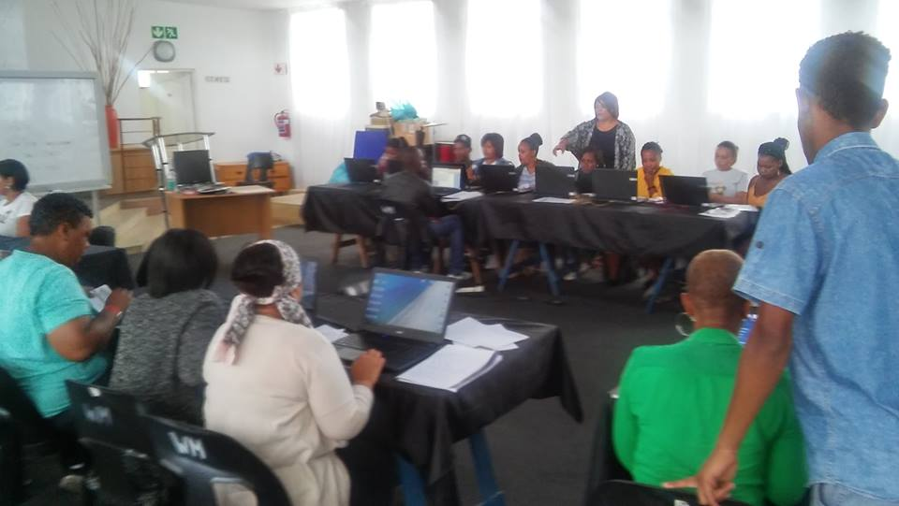
Computer and Life Skills Academy
We offer a 8 week (3 days a week with 2 hours per session) course in computer literacy covering Intro to computers, Typing skills, MS Word, MS Excel, MS PowerPoint, MS Access, Internet and email. A free life skills week is offered in professional job seeking, personal development, project and events management, money management, customer relations, professional networking, project/event management and effective stress management. Basic office admin is also included. A special Community Investment Programme targets volunteers from NPOs and community groups who receive bursaries to attend this training. Only an admin fee is charged. This training was interrupted during the Covid-19 crisis and presented online via WhatsApp.
Computer training in action!

Slide 25
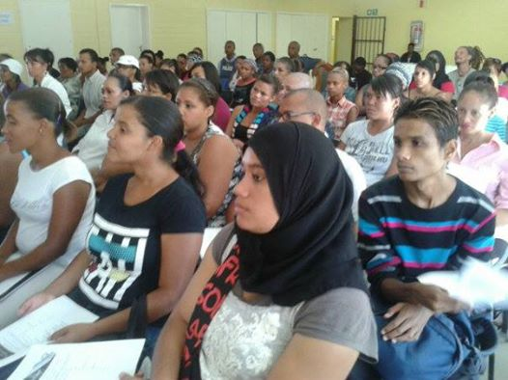
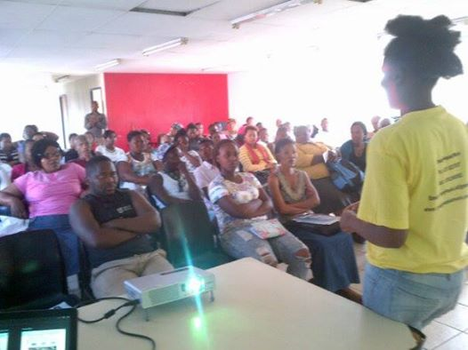
Life skills training
Life skills sessions in action!
A basic office admin session in progress
A professional job seeking skils workshop in progress

Slide 26
Other projects
Practical office administration (This is 3 day practical course for beginners who would like to explore the field of office admin as career. It covers the entire spectrum of the tasks of an office administrator. Participants are also exposed to a special free session facilitated by the director on the relationship between office admin and the rest of a company/organisation. Specialists are also brought in to share skills and experiences.) Fee: R350 pp (unemployed) R400 (employed)
Radical Car Wash (This project was started to promote employment amongst unemployed youth especially school drop outs. The focus is not just washing cars but developing career plans for the employees to pursue their passion. The car wash offers a mobile service, going to the clients, saving them time and money.)
Youth Business Network (In response to the Covid-19 pandemic and with the decimation of jobs, this project was launched. Its aim is to support youth based businesses to move from survival to thriving. A big workshop is hosted followed by a selection of 6-8 participants over 3 months where group and individual mentoring is provided. Fee: R50 pp. A variety of guest speakers are invited to engaged with participants in various fields related to business.
Master Train the Trainer Course (This is a 3 day course facilitated by Frank Julie and Yolanda Van Steer (assessor, moderator and skills development facilitator. It is aimed at individuals who are already in the training field but need to improve their skills or those who plan to make training and facilitation a future career.)

Slide 27
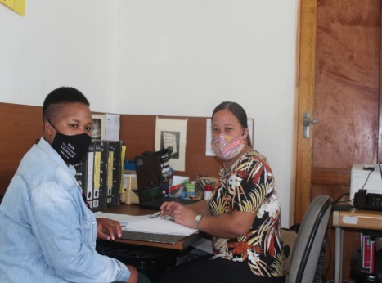
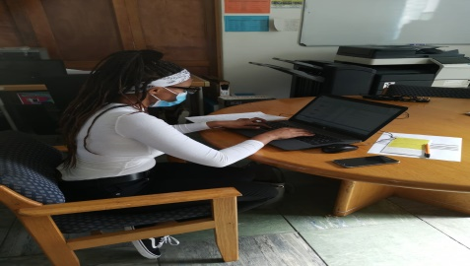
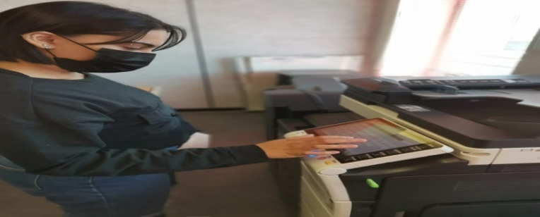
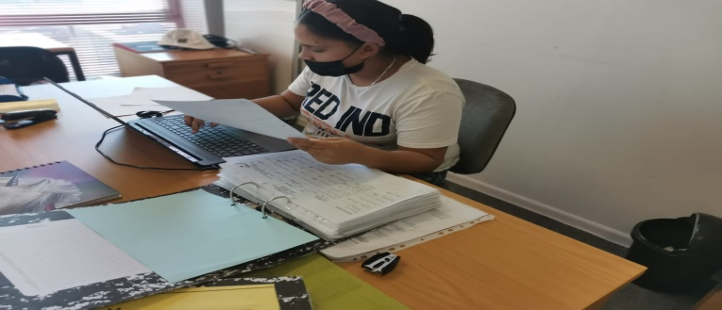
Practical Office Admin Training

Slide 28
Feedback from students
Bernelee Baker wrote:
“This was a very interesting and fun course. I have learnt a lot within the 6weeks, where I now feel like a professional at home, by teaching my husband, based on the exercises we did in the class. Thank you YP@W.”
Cedwyn Klein wrote:
“It was very educational, uplifting and inspiring. I truly enjoyed my time here in the 6wks computer training, as well as Miss Shirley's teaching. Thank you!”
Feedback about the practical office admin training:
Precious Bigone wrote:
“It was such an awesome experience to be hands on. It is an honour to be taught by a very humble and phenomenal trainer. She avails herself for every small task you ask her. I will definitely come back for more courses.”
Shannen-Lee Bruinders:
“I understood everything very well, the facilitator was great and had a lot of patients and i am truly grateful for this course. I can say that I have definitely gain loads of knowledge.”

Slide 29
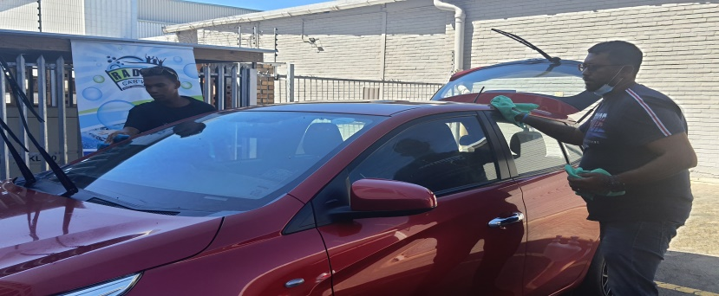
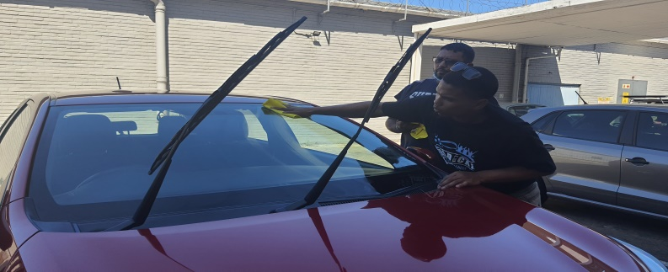
Radical Car Wash

Slide 30
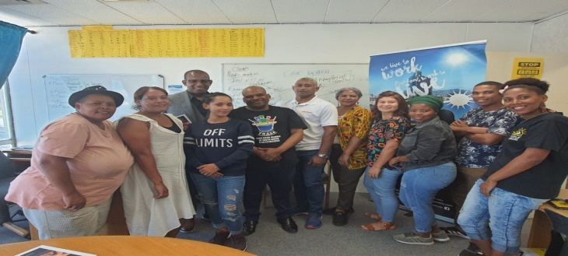
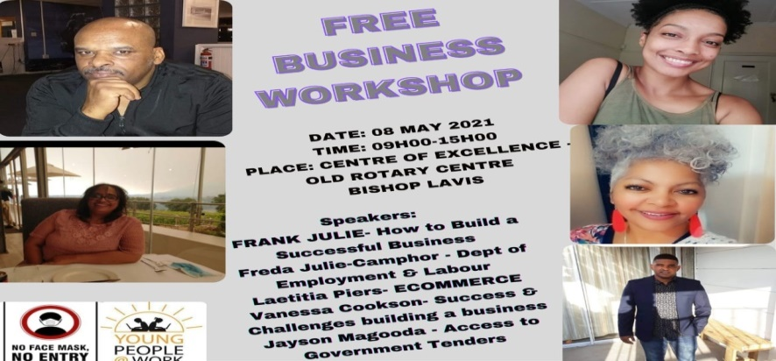
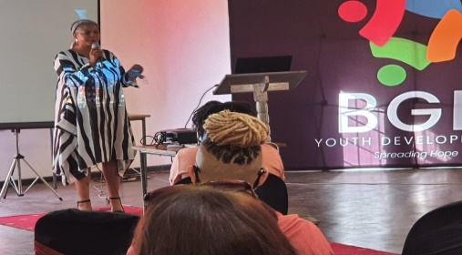
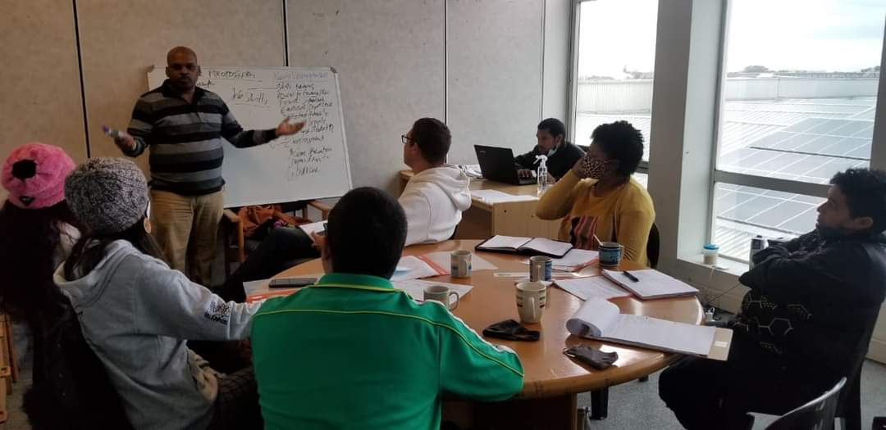
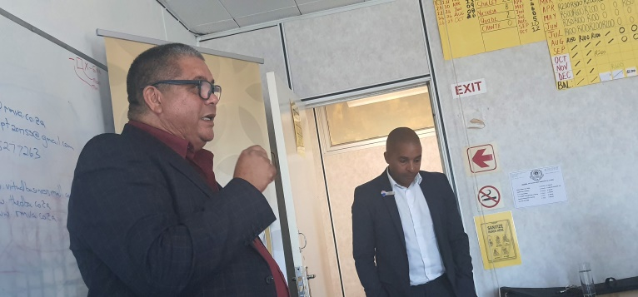
Youth Business Network

Slide 31
Feedback from Jacoba Hamman
“I am a proud business owner of a catering and food product company named WTT SWEET $EATS (PTY).I am also a proud member and mentee of the YoungPeople@Work business mentoring network. I have started my catering company through the support and mentorship of Mr Frank Julie, a friend, supporter and partner last year February.
Throughout the mentorship and journey, I have learned so many things. The MAIN thing that have learned from him and these mentoring sessions coordinated by him and Vanessa Cookson, is having multiple income streams in your business. Which mean, when one income stream generates money slowly, there should be another to fill the gap and generate enough for you to be in business, to stay relevant and for your business to not DIE on you! Since the start I have implemented this strategy in my business.
There are so many avenues now in which my business can prosper in and make money. For the last 1 year and a half, we have done catering for workshops, funeral, lately one or two weddings, baking cakes and biscuits and selling thereof. My husband recently joined the company and its daily operations when he was retrenched. About 6months ago we introduced our fresh produce department, to the public, where we do pre-cut/fresh cut vegetable and smoothie packs. We have been selling these products for the last 6 months to the public and the growth has been phenomenal. We have just started supplying 3 old age homes with bigger than normal veggie packs and are also looking to supply preschools, restaurants, more nursery and old age homes etc.
Our clients rave about these products and love the freshness of the product itself. It's also convenient for them and the veggies are pot ready, which means they don’t have to go through the motion of having to peel and cut their veggies. Though we still have many challenges with getting our own space ,own transport and other things, we are confident that we will soon reach that level...We have over a 1000 followers on our page.

Slide 32
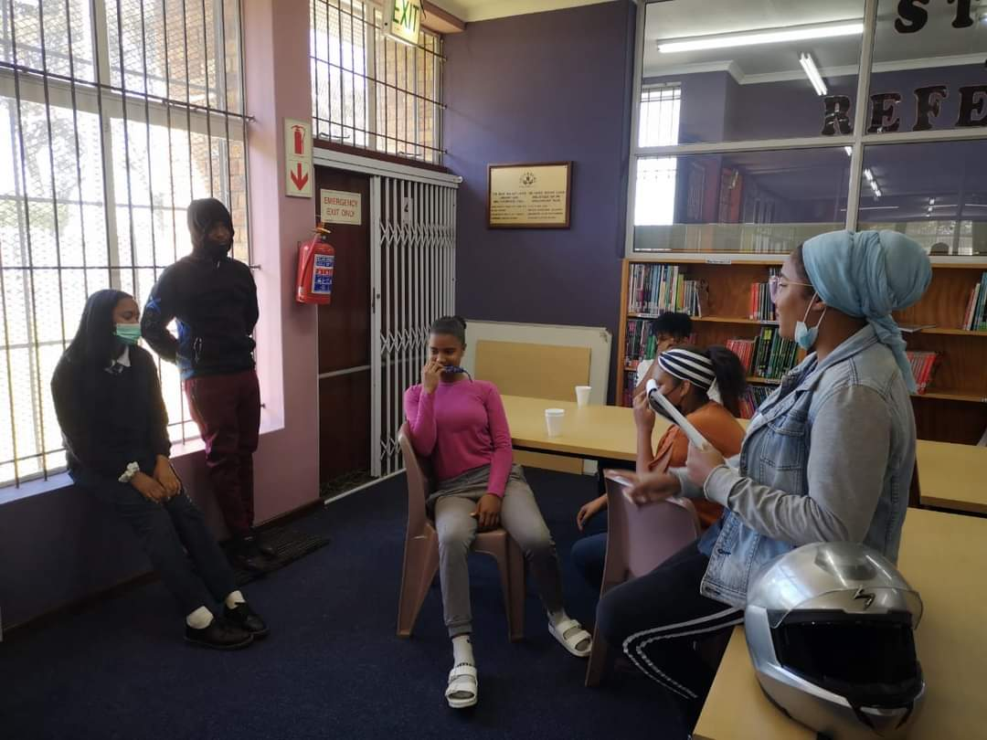
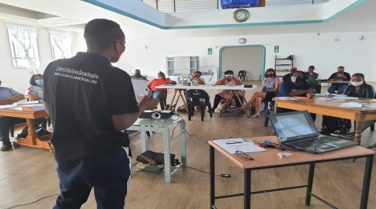
Master Train the Trainer Course

Slide 33
Feedback from Bridgette Adonis
I would like to take this opportunity to thank you for affording me the opportunity to sit in with Shirley on Tuesday and just absorb the brilliance of her work. She is very gentle and genuine with her learners and definitely knows how to read the need or identify learner styles.
The students were very much engaged and acknowledgement of each of them can contribute. Her lesson was well prepared and I thoroughly enjoyed listening to her voice. I really would have loved to see more of the 6 week training, in order to evaluate or elaborate more.
I could definitely link the theory and practical almost immediately...much to my surprise. I look forward to joining you guys again as I feel there's so much more I can and should learn, not only in this industry but for myself personally. Regards. (Bridgette Adonis, Facilitator, Children Have a Dream Foundation)

Slide 34
Our approach to life skills training
Our life skills intervention is part of offering a holistic intervention to youth unemployment. Instead of just focusing on finding employment and keeping a job, the focus is on finding oneself. The aim is to develop a consciousness of self, understanding life in a rapidly changing and unpredictable world where the job market is in constant flux.
Our focus is not just to provide a docile labour force to the economy but youth who are critical about the nature of the economy and how it is designed to serve the interest of a few. We also create awareness of rights of employees in line with current legislation protecting them.
We have discovered that many participants are attracted to our admin workshops. We are not yet certain why this is so but we usually record at least 250-300 enquiries and 80-100 participants to these workshops. Our approach is to use these workshops as a feeder to our life skills week (4 workshops) and computer classes. This has proved very successful and has enhanced our quantitative impact.

Slide 35
Our approach to learning and education
Our approach to learning and education is premised on 3 adult learning theories:
Experiential learning (making use of the real life experiences of participants to understand certain concepts applying a process of conscious reflection.)
Popular education (Based on the work of Paulo Freire, we create awareness about power relations in the process of building knowledge. Participants and trainers are treated as equals. Our focus is to sharpen awareness about the need for social change instead of just slavishly accepting the status quo.)
Situated learning (based on the work Prof Jean Lave and Prof Eric Wenger, we promote learning by doing. Learners learning processes are respected and there is no pass or fail approach. Instead learning is viewed as a continuous journey of self-discovery. Learners are encouraged to become active participants in a community of practice and all potential barriers are removed to facilitate such participation.

Slide 36
Our strategic partners
Partner | Value added
Department of Labour Freedom SA Nsfas | Register youth on their database; share valuable information Clearing criminal records Bursaries for tertiary education
RLabs Social Media Academy | Offers free scholarships in social media, project management, photography, events management, web design, entrepreneurship , office management
Dreamworker Ladies Now | Interview and register the unemployed to match their skills with available jobs. Driving lessons
Hair Aid Academy Food Relief Alliance of SA | Offers hairdressing learnerships to participants Offers free computer training space
Community libraries | Offers free space and computers for training
Harambee/I-College/MfesaneAdcorp Blu | Offers job placement and training opportunities
Community libraries | Job shadowing opportunities
Media (Community radio, Cape Town TV and newspapers) | Access to free airtime to market our work
Kolping SA / New Day United | Offers bursaries in the field of home-based care, hairdressing, plumbing, welding, office admin, etc.

Slide 37
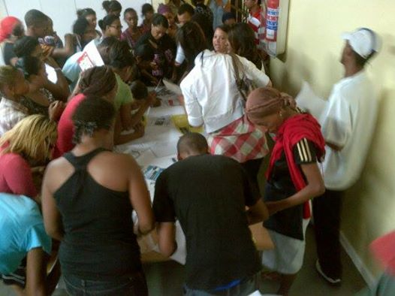
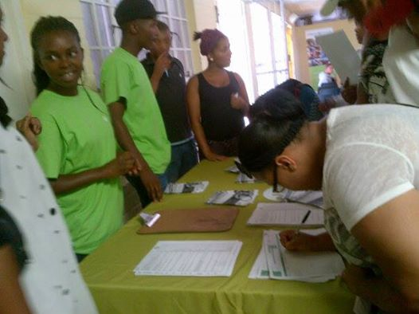
About partnership development
Our approach to networking
We are very strategic about who we network with. Unless an organisation is directly involved in adding value to an unemployed person, we are very sceptical about working together. This is because it takes lots of times and resources to maintain network relationships.
We expect our network partners to report to us about unemployed youth referred to them or signed up by them during our workshops.
Our network relationships are based entirely on win-win. We create the space for our partners to have access to unemployed youth. This enables them to sign up candidates for their respective programmes.
Over the last 4 years we recruited new partners and stopped relationships with others based on our criteria of partnership development.
Rlabs Social Media Academy Harambee Youth Employment

Slide 38
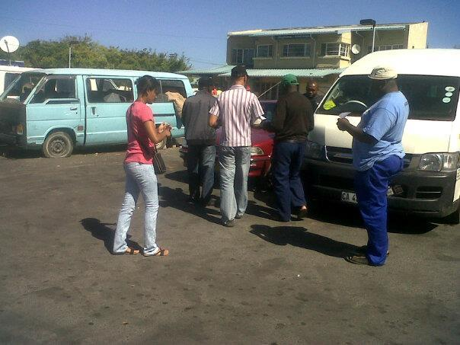
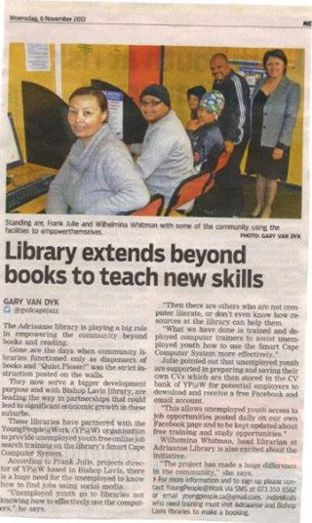
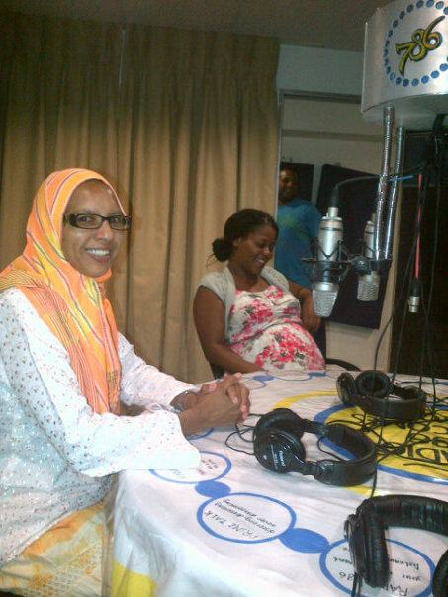
How we market our programmes
We market ourselves using community radio, Cape Town
TV, newspapers, social media, word of mouth, murals; T-shirts, website, SMS alert system, newsletter (distributed 4 times per annum electronically), block emails, leaflets/posters at strategic places (schools, libraries, churches, surgeries) fieldwork, CIS outreach, exhibitions, door to door pamphleteering, library exhibitions, presentations, referrals, word of mouth, web links, WhatsApp groups, etc.
Handing out leaflets at Langa taxi rank
Article in the Tygerburger
Interview on Radio

Slide 39
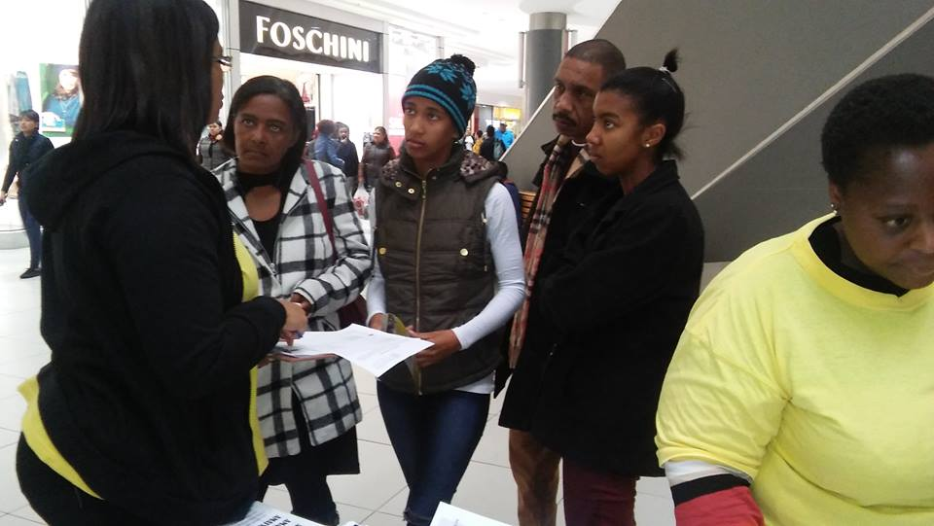
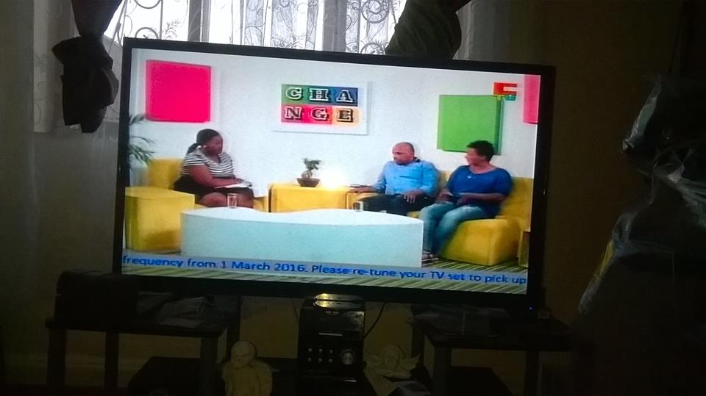
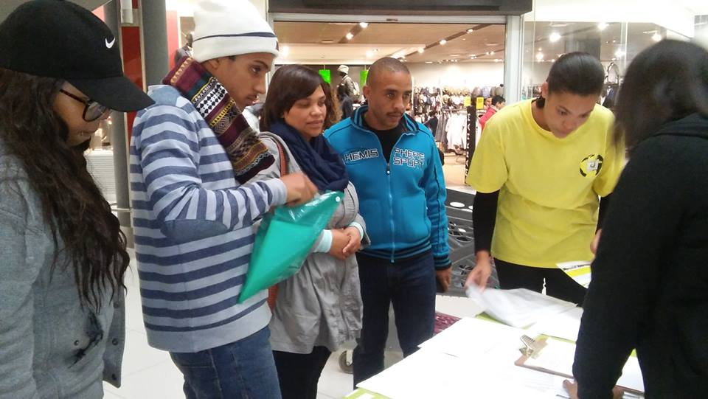
Marketing via public exhibitions and Cape Town TV

Slide 40
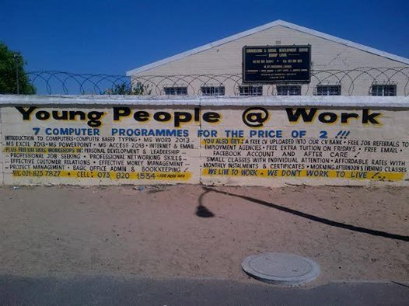
Marketing via public murals

Slide 41
Our approach to marketing
We take marketing very seriously. It is of no use offering free access to your programmes when very few people know about it. Our aim is to allow as many unemployed youth access to our programmes hence we use a mix of marketing tools with a big emphasis on social media such as Facebook. Our focus is to build our following on Facebook to minimize the cost of marketing. To build this following we deliberately feature stories of our beneficiaries, collected by our trainers, with whom our followers can relate to recruit more people to our page. We are currently at over 65 000 followers and aim to build this up to 100 000 in 2024. We started with exhibitions at a local shopping mall which proved very effective but was interrupted due to Covid-19.
We have a dedicated person coordinating our marketing strategy and provide feedback in our weekly management meetings. All staff and volunteers are educated and involved in the execution of the marketing strategy. For example trainers facilitating online job search and computer training will forward photos of their sessions for posting on Facebook. Photos of our life skills and youth empowerment weeks are also posted. Information advertising employment opportunities or learnerships are also posted on our page, allowing youth instant access to existing opportunities. Facebook posts are shared on many other pages to reach a bigger audience.

Slide 42
Our donors and supporters
So far, our work has been funded or supported by:
Adonai Life (offers free training and office space from 2013 until September 2014) (value: R120 000 p.a.)
Frank Julie and Associates (free coaching, mentoring, management support, board development, fund development, train-the-trainer, life skills training, marketing) (value: R30 000 p.m. – ongoing)
HCI Foundation (financial support towards our online job search training until 2015)
Grandwest CSI (financial support towards equipment and marketing in 2014)
Stichting Projechten Zuid Afrika (SPZA) (Netherlands) (some operational costs, life skills and train-the-trainer workshops until 2015)
Kerk in Actie (Netherlands) (covers some operational costs, 2016-2024)
Forza Foundation (Netherlands) (covers operational costs – 2020-2022)
Wilde Ganzen (Netherlands) (Master Train the Trainer, Youth Business Network – 2021-2022)
Individuals from Utrecht in The Netherlands
Metropolitan Health Group (once off donation of
2nd hand computers)
Radio 786 (free airtime)

Slide 43
Continue…
Fire Tech (Bellville) (once off financial donation (2016) and donated 2 new computers)
Community Chest (Life skills workshops and online job search training and donations in kind) (2017)
King Baudouin Foundation (Belgium) (Life skills workshops – 2017/18)
Department of Social Development (2nd hand computers)
Department of Social Development (DSD) (Operational funding) (2017/18)
National Lottery Commission (Operational and programme funding) (2017/18)
Various professionals in RSA and expatriates around the world connecting with us via Facebook (financial support and intellectual capital, ongoing)
Bishop Lavis Informal Traders Association; Achfa Projects; St. Mary’s Home (once off material donations)
Our own income generation activities such as computer fees, CV s and certificates, staff and board fees, sale of computer parts, donations in kind from students and small businesses, special events, rummage sales, interests derived from savings, sale of T-shirts, manuals and volunteer labour to reduce operational costs, discount on rental, free access to training spaces, etc.

Slide 44
Our fundraising strategy
Building YP@W from the ground was a huge challenge. Our first year was a struggle to finance our work. We depended on volunteer labour and the time our founder could spare to assist in the building of the organisation. SPZA based in the Netherlands was generous in supporting us even though we still had to become legally compliant. In June 2013 and once members were trained as computer facilitators, we started to generate some income. Over the last 3 years we consciously developed various income streams to become less dependent on external donors.
Our staff and volunteer base as well as our strategic partnerships still form a huge part of our resource base. We are still only able to pay 80% of market related salaries to our staff. We hope to increase this in 2017.
Access to funding from international and national donors have helped a lot to sustain us and reduce staff and volunteers exiting. We also expanded our individual base of donors via Facebook.
Currently our computer training income forms the bulk of our income base. It is a base that we are constantly expanding. In 2015 we opened a new training centre in line with this objective. We are currently financing about 20% of our own expenses. Our aim is to increase this to 40% in 2024.
We had an almost 50% reduction in our income during the
Covid-19 Pandemic due to the various restrictions.

Slide 45
Job placement and tracking
Despite a stagnant economy there are still many opportunities for youth to access sustainable employment. The youth wage subsidy and jobs fund has also incentivised companies to employ more young people.
Initially, due to a lack of funding and human resources, this aspect of our work was very ad-hoc. As we stabilised we became more focused since this is the ultimate test of the relevancy of our intervention. We allocated staff to specifically place and track our beneficiaries. We built partnerships with companies and became the port of call for others to source potential employees.
Our placements focused on permanent/temporary employment, job shadowing to gain work experience and learnerships/internships.
Tracking forms an integral part of our placements. It means keeping in touch with placed candidates to check what they do and how the skills they acquired from us are being applied. It also helps us to measure the impact of our intervention in terms of income earned and secondary beneficiaries.
We have a job placement form that all participants fill in to be placed on our employment database. When requests are made for placement we check our database and refer candidates.

Slide 46
What we monitor and evaluate
To evaluate the outcomes and impact of our youth intervention, we use the following indicators:
Nr. of participants employed (permanent/temporary), monetary value of the employment and the number of dependants benefiting.
Nr. of participants placed in job shadowing and the hours spent. The nr of days/hours spent doing actual work is multiplied with the hourly rate that was supposed to the paid.
Nr. of participants placed in learnerships/internships and the value of the training if they had to pay for it. Also any income derived from the placement whilst in training.
Nr. of participants attending all our training courses (life skills, computer, online job search, community investment programme) and the potential market value of the training if provided privately.
Nr. of hours of voluntary work performed by volunteers multiplied with the market related hourly rate.
Nr. of hours worked by staff multiplied with the market related hourly rate less their current salary (50% of what they should earn).
Discounted/free training provided to staff/volunteers and material donations provided by partners and participants during workshops.
The results of this evaluation are captured in our annual report.

Slide 47
Stories and faces of a successful intervention!
“Dear Frank Julie I don't know if my wording is going to be right. You would not know what fantastic news I have. I have received a call today that I'm starting on Monday at The Foschini Group (TFG) do you know because I did my training through you. I have aced my assessment 96% for vocal and my typing. Thank you for making a difference and changing lives. Now I am ready for the new challenges. Thank you Frank Julie now 2012 is ending well. Keep on what you doing by making a difference.”(Nazeema Terblanche)
"Hi Frank (during the time of RAG)
How are you doing? I read an article in the Tygerburger about you doing a workshop in Lavis next week. So I wondered if it was you when I saw the name Frank Julie. I did the computer training course at R.A.G (2004) and attended all the workshops. The ones you presented, Karriem, Fathien Jacobs and all those. The workshops at R.A.G really made me realise that there are questions I need to ask myself about what I want out of life. Just want to thank you, all those workshops impacted on my life in a positive way. I went on to complete a B Com degree in Information Systems at UWC. Currently working for Telkom as a Java web services specialist. Next year I plan to do my honours through Unisa. I hope those who will be attending you workshop will take and learn from it what I have. Once again thank you.“ Ashwin

Slide 48
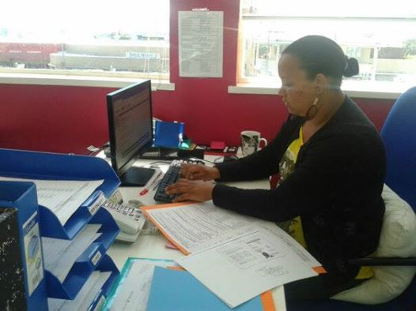
Success story – Victoria Petersen
Victoria Petersen (or Vicky as we call her) lives in Elsies River and joined as a volunteer in August 2013. Before joining YP@W she did contract work at various companies. She attended various computer courses at YP@W and subsequently trained as a computer facilitator. She is currently busy with her second social media course at RLabs. She mirrored (or shadowed) Frank Julie for a few weeks. Since April 2013 she started work as a fieldworker for Dreamworker, Vicky is a very hard worker and very committed to her community. She also facilitates voluntary online job search training as Adriaanse community library in Elsies River. From a fieldworker at Dreamworker she was quickly promoted as office manager. She is married with 2 children.

Slide 49
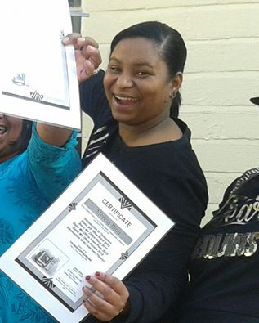
Other success stories!
Mercia Blou – Optic Pharmacy – Bellville
Josephine Silbourne
SAPS – Canal Walk
Aubrecia Arendse
Department of Justice
Jene-Lee Kampher
Two Oceans Marketing
Isaac Mpofu
Accountant

Slide 50
Natricia Hendricks – City of CT / Bishop Lavis Sisanda Gabada / Home from Home
Zadeen Gelderbloem
IT facilitator
Mary-Ann Bergman ECD and Youth facilitator – City of CT
Shaggy-Lee Miller
Chef
Lebumasil Masilo/Real Eastate

Slide 51
Job shadowing/Department of Labour, Internships at Sanlam Insurance and Hairdressing Learnership

Slide 52
Referrals by YP@W
We also act as referral agency or intermediary between placements agencies and unemployed youth in communities.
Here is an example of unemployed youth being assessed by Harambee in Plettenberg Bay, George and Mossel Bay. 54 candidates were placed.

Slide 53
Feedback from our Facebook page
Rose De Klerk wrote:
YP@W has made a profound impact on my life.
I attended the 3 day- workshop in Bellville Library hosted by Frank Julie. What an awesome and inspirational presentation delivered by him! He awakened the potential I knew I had but did not have the ability and skill to uncover myself. I left the workshop with such confidence and direction. I now have a “ Yes I can “ mentality and a clear vision of where I want to go. I then made use of the opportunity to enrol in the computer classes. Shirley was such a competent and patient teacher that took us step by step. I have such gratitude for her and Mandi who through sacrifice, dedication and commitment ensured that we all took our lessons seriously. I am now more informed and knowledgeable about MS Word, MS Excel, MS Access, PowerPoint and the Internet. Thank you YP@W for inspiring me to become motivated about job hunting and my future career. I will apply the skills that I have learned and not procrastinate anymore.
Shannon Adams wrote:
Good Evening . I Would Just Like To Thank YoungPeople@Work For The Three Day Workshop. It Was A Great Experience , It Was Very Helpful And Insightful . What You Guys Are Doing For The People Is Amazing , Not Anybody Would Go Out Of Their Way For Others , Not A Lot Of People Are Willing To Help Each Other , They Like To See You Fail But You Guys Helped Not
Me But Many Others , Giving Up Is Never The Way Out. Thanks
Again For Being Such Amazing People , God Bless You All. Waking Up That Early Was Definitely Worth It. Keep Up The Good Work!

Slide 54
From retrenched clothing production manager to YP@W Operations Manager!
“Since I started out as a mere volunteer at YP@W, I can proudly say that I have grown tremendously, as a person. I have grown with so much confidence and it is all due to being introduced to various training programmes and opportunities which made me feel more empowered. When I think of how little (I can call it “little” now) I knew about computers, office administration; operation management; and even facilitation, in comparison with what I know today, I can only applaud the people who have taught me what I now know.
All of the above is easier said than done, and at YP@W, it is all about planning strategically, sitting in meetings to discuss an upcoming event and then slowly but surely see how it all falls into place when a hardworking TEAM starts putting the puzzle together. I am amazed at how easily I can put a report together nowadays, how I can prepare a computer lesson with proper planning and ease….because I was taught that knowing your content, will make the applying thereof much easier and more effective! From being a volunteer I am now a
qualified computer facilitator, training basic, interme-
diate and advanced application programmes. I manage
the other facilitators, do bookkeeping, office admin and
even serve on the boards of YP@W and People First
Foundation! Recently I completed my accredited SDF
training through the Services SETA!
I am still SMILING, and it is now 3 and a half years
later, thanks to YP@W!!!” (Shirley De Jongh)

Slide 55
Feedback from partners
“Dear Frank
Thank you for meeting with various divisions of DSD on 24/2/14. Your program is really amazing and so cost effective and empowering - so many lessons we learnt already in just this one session. We and other NPOs can learn a lot from you.
We hope to continue the relationship we have started and I know great benefits will come from us working together towards the great goal of opportunities for youth.”
Deborah Dreyer, Senior Director, Department of Social Development
“Department of Labour (Bellville office) has established and strengthen relationships with YP@W as service provider since 2012.
The above organization has been instrumental in developing young unemployed persons and has become an extension of our services to the unemployed population. More that 1000 clients referred from our database have been successfully assisted through their specialized intervention. We continue to support any initiative or structure that expresses our mandate to the benefit of the marginalized.
Ms Freda Camphor, Assistant Director: Public Employment Services, Department of Employment and Labour

Slide 56
Who is involved?
Board of Directors
Estelle Hendricks – Chairperson (Director and founder of All On Board Training Solutions; she has played a dynamic role in empowering our initial volunteers with computer skills; currently the managing director of Quin’s Cleaning Company)
Marileze Johannes - Treasurer (She was the founder of Eyona-Yona Job Placement Agency; she joined RAG at the age of 12 and became the computer project leader in 1993. She qualified as a trainer whilst still at primary school.)
Frank Julie – Director (MPhil in Adult Education and Training; also director of Frank Julie and Associates; Chairperson of People First Foundation, FRASA, Fundraising Mentoring Network, Music Academy for Rural Youth, Youth Business Network and Radical Car Wash)
Ronald Wesso – Vice-Chairperson (Researcher, community mobiliser)

Slide 57
Continue…
Shirley De Jongh – Minute secretary (she also serves on the board of People First Foundation, Fundraising Mentoring Network and FRASA).
Victoria Petersen - (member) She used to be a volunteer who joined in 2012. She serves on the board of YP@W as a staff representative.
The board meets 4 times per annum. Progress reports are submitted at least one week before each meeting. Financial reports are submitted at board meetings. Copies of bank statements are circulated to board members in advance. Our bookkeeping is managed by HGG Financial Services.
Financial planning happens on a monthly, quarterly and annual basis.

Slide 58
Staff members
Frank Julie
Executive Director
Shirley De Jongh
Operations Manager
Victoria Petersen
Computer facilitator

Slide 59
Continue
Chante Rass
Office administrator and facilitator
Quade Swartbooi
Computer facilitator
Amy-Lee Julies
Assistant office administrator

Slide 60
Continue…
YP@W is registered as a Non-Profit Company with registration nr. 2012/210099/08 NPC. PBO registration: 930062239 IT: 931/031/18/5
We have a small core staff working fulltime for YP@W to minimise overheads surrounded by professional strategic advisors who help to facilitate free workshops.
Our contract computer facilitators work at community libraries.
We recruit volunteers when the need exists. They get free training to build their capacity. Volunteers are required to record their volunteer time and receive credits for their involvement.
Our staff and volunteers are 80% female and 20% male.
We have weekly management and planning meetings, with a check-in on a Friday and a rotational chair. We are financially transparent with weekly updates and reports submitted monthly. Our financial admin has been outsourced to Mzansi Business.

Slide 61
Continue…
Strategic reviews happen twice per annum in July and December/January.
Staff/volunteer development is on-going with Fridays and Mondays (known as home days) allocated for special training, debriefing and support work.
Trainer council meetings are held as the need arise and where trainers can share experiences and results of evaluations are discussed. In this way we try to maintain high standards.
Our senior trainer has completed an accredited skills development facilitator training. We conduct regular evaluations of our trainers to maintain high standards of competence.

Slide 62
Our philosophy

Slide 63
Auditors and Banking info
MZANSI BUSINESS
Registered Auditor and Tax Practitioners (SA)
Tel : 021 820 9925
Cell: 074 200 1703
Email: cheryl@mzansibiz.co.za
OUR BANKING DETAILS:
Bank: First National Bank
Branch: Parow
Code: 250655
Account nr: 62388828190
Type: Business Cheque

Slide 64
Our contact details
Contact us here:
262 Voortrekker Road, Parow Office Park, Parow, 7500
Telephone/SMS: 021 911 5444
Fax: 021 911 5444, Cell: 073 820 1534 / 063 424 8665 (text only)
Email: youngpeople.za@gmail.com
Website: www.youngpeopleatwork.weebly.com
Facebook: https://www.facebook.com/YoungPeopleWork
WE SERVE OUR PEOPLE WITH PRIDE – THE REWARD IS IN THE GIVING!
HELP US FIX SOUTH AFRICA FOR THOSE WHO WILL INHERIT IT!!

